Slide 1
/Users/iqbio2014/MATLAB Modeling/Newest Version
Uploaded my current data, parameters, and scripts
You can access this through vieques or by mapping your network drive

Slide 2
Inhibitor
01
02
03
04
05
06
07
08
09
10
11
B
B
C
C
D
D
Empty wells for flatfield correction
E
F
G
W1=FRET
W2=CFP
W3=Brightfield
EKAR sensor
Timecourse: 0hr plate is every 16.3 minutes
6hr plate is every 20 minutes
Use multiple sites for error
This is a lot of data, finding a way of presenting it clearly is important

Slide 3
Inhibitor Concentrations
Inhibitor
02
03
04
05
06
07
08
09
10
11
GM6001
BMS
Gefitinib
ZM33
CI-1040
SCH7
B
0 | 156.25 | 312.5 | 625 | 1250 | 2500 | 5000 | 10000 | 20000 | 40000
0 | 29.29688 | 58.59375 | 117.1875 | 234.375 | 468.75 | 937.5 | 1875 | 3750 | 7500
0 | 19.53125 | 39.0625 | 78.125 | 156.25 | 312.5 | 625 | 1250 | 2500 | 5000
0 | 15.625 | 31.25 | 62.5 | 125 | 250 | 500 | 1000 | 2000 | 4000
0 | 19.53125 | 39.0625 | 78.125 | 156.25 | 312.5 | 625 | 1250 | 2500 | 5000
0 | 31.25 | 62.5 | 125 | 250 | 500 | 1000 | 2000 | 4000 | 8000
C
D
E
F
G
Groups: Jamie, Antony, Carter – Rows B, E, F
Patrick, Kristen, Chris – Rows C, D, G

Slide 4
GM6001
ERK activity never reduced to basal level
The longer from EGF addition, the greater the effect

Slide 5
BMS
Same trends as GM6001
Side by side, GM has an increased effect compared to BMS
Effect more similar in later timepoints

Slide 6
Gefitinib
Lowers Signal past sensor dynamic range
There does appear to be memory differences between 0hr and 6hr

Slide 7
ZM33
cRaf inhibitor
Does not effect important signal transducers such as bRaf
Almost no effect on EGF->ERK
Did not see signal activation
Perhaps from basal level we would?

Slide 8
CI-1040
Similar trends to Gefitinib
Also shows memory differences between 0hr and 6hr

Slide 9
SCH7
Also lowers outside of dynamic range of sensor
Does not show memory from EGF treatment

Slide 10
Delayed Inhibition Varies Inhibitor Response
0 hr EGF Treatment
6 hr EGF Treatment

Slide 11
Delayed Inhibition Varies Inhibitor Response
0 hr EGF Treatment
6 hr EGF Treatment

Slide 12
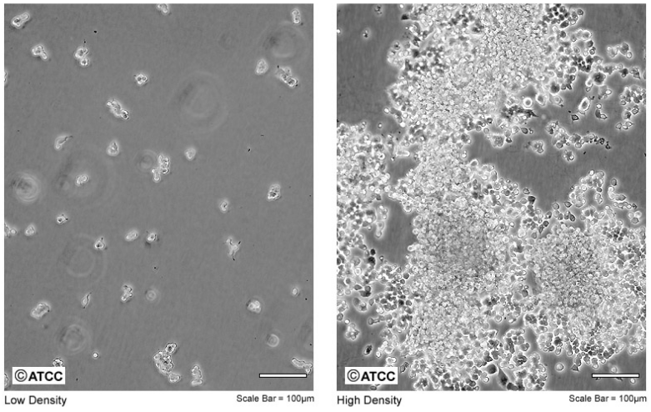
2009 Reasoning
PC12 Cells
PC12 cells show differential ERK dynamics based on which growth factor is used
They used this model to show differential signaling through EGFR vs NGFR
System for neural differentiation
ERK dynamics in response to EGF or NGF are very different
Model used to study negative feedback in ERK pathway
BMC Syst Biol. 2009 Oct 5;3:100. doi: 10.1186/1752-0509-3-100.
Computational modelling of cancerous mutations in the EGFR/ERK signalling pathway.
Orton RJ¹, Adriaens ME, Gormand A, Sturm OE, Kolch W, Gilbert DR.

Slide 13
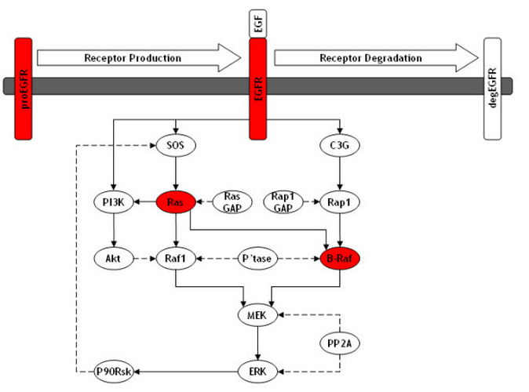
2009 Model Scheme

Slide 14
2009 Model Predictions for EGF Treatment

Slide 16
EGF-l
EGF-l
TACE
TACE
proEGF-l
EGFR
EGFR
PI3K
SOS
SOS
PI3K
GAP
RAS
RAS
AKT
AKT
PPase
RAF
RAF
PP2ase
MEK
MEK
p90Rsk
ERK
ERK
p90Rsk

Slide 17
HaCaT Cell RNAseq Copy Numbers
EGFR 118.896
SOS1+SOS2 12.02597
hRAS+kRAS+nRAS 72.37833
RAF1+bRAF+aRAF 39.81119
mapk2k1 19.4423
mapk1 56.6077
rps6ka1 28.2139
adam17 8.14618
tgfa 23.7658
PIK3CA 4.93454
akt1+akt2+akt3 53.51433
pp2ca 47.0607
ppp5c 26.0417
rasa1 14.7541
Used for synthesis parameters
The rest will be assumed proportional to steady state values

Slide 18
Immunofluorescence
Goal: to determine fraction active ERK under experimental conditions for model fitting
Conditions:
PBS – no secondary AB
CI-1040 (1 uM)
PBS
EGF (100 pM)
EGF (1 uM)

Slide 19
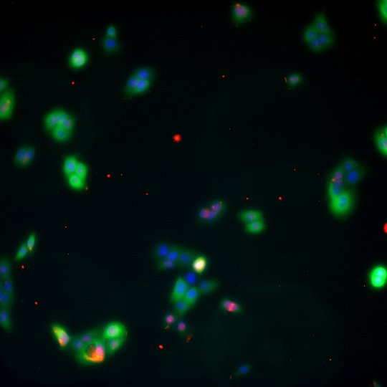
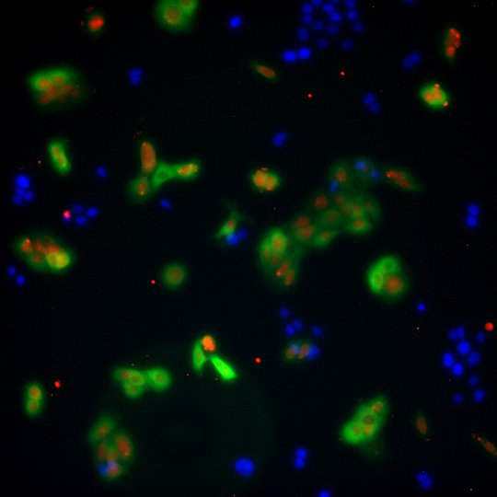
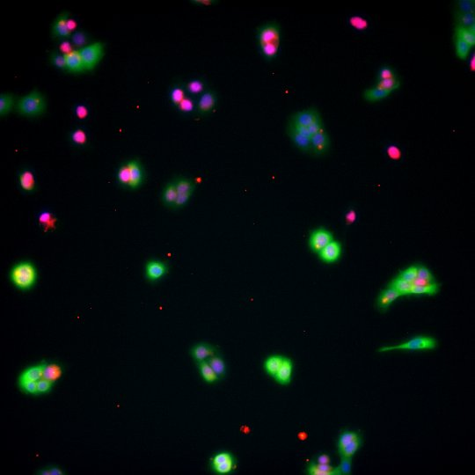
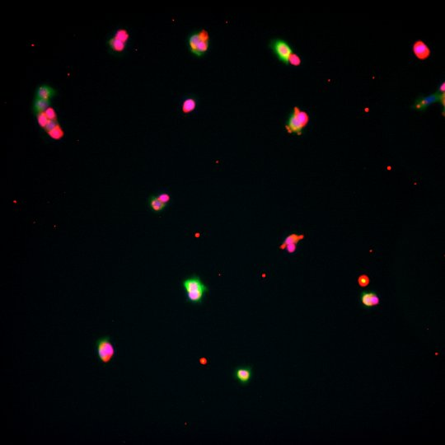
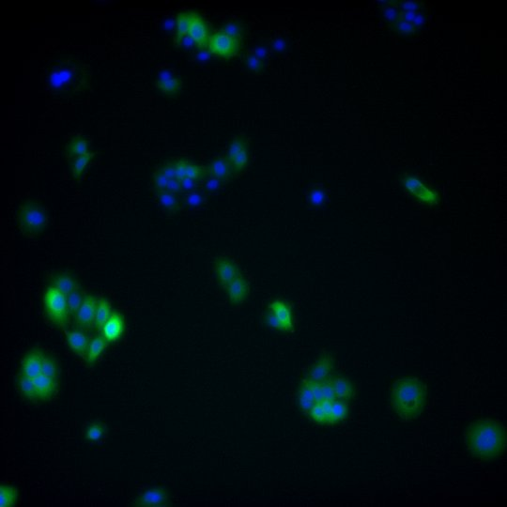

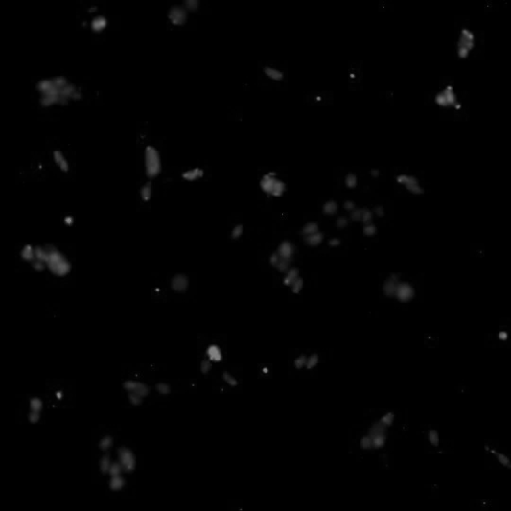
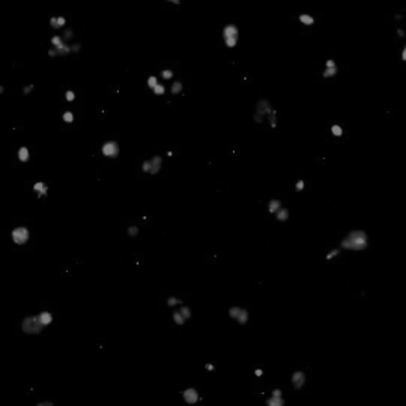
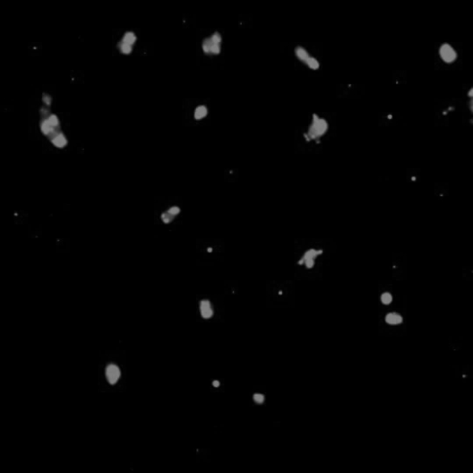
EGF
(100pM)
EGF
(1uM)
CI-1040
PBS
Overlay: DAPI,YFP,AB
IF-ppERK

Slide 20

Results
Subtracted background well
Called CI-1040 min and 1uM EGF as maximum
Calculated fraction saturation
$$\frac{Exp−min}{Max −min}$$
: Equilibrium: 21%
: 100 pM EGF: 48%
CI-1040
PBS
EGF
(100pM)
EGF
(1uM)

Slide 21
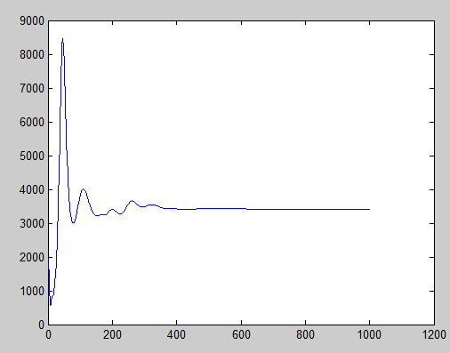
Initial Conditions
Each time I change parameters I achieve a new equilibrium
I run for 1000 iterations then use end result as new initial conditions
For fminsearch I only use 300 iterations but it should already be close

Slide 22
EGF on Cells
Didn’t want cells to see all molecules at once
Or internalize all EGF near them
So I made a stipulation that EGF levels cannot fall below well concentration
Total EGF molecules
10⁹ per well
Diffusion
Local EGF molecules
~10² per cell
Internalization
Cell
Cell
Cell

Slide 23
EGF on Cells
But they can exceed the well concentration
Total EGF molecules
10⁹ per well
Local EGF molecules
~10² per cell
Shedding
Cell

Slide 24
Model Architecture
Excel Spreadsheets
Executable Scripts
Functions
Simplified Values
Parameters
Initial Conditions
RunTimeCourse
func2_TimeCourse
Inhib Values
Inhibitor Concentrations
Experimental Data
run_fmin
func_ODEs
func3_fmin

Slide 25
Model Architecture
Excel Spreadsheets
Executable Scripts
Functions
Simplified Values
Parameters
Initial Conditions
RunTimeCourse
func2_TimeCourse
(provides y values over a time course, given perturbations)
Inhib Values
Inhibitor Concentrations
Experimental Data
run_fmin
func_ODEs
(provides dy,
used in ode23s)
func3_fmin
(provides an r²)
(This is basically your legend as to what parameter is what right now)

Slide 26
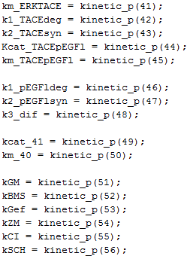
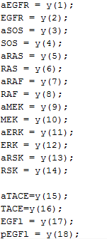
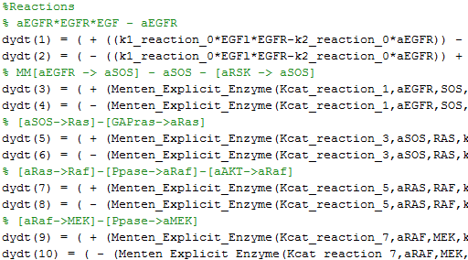
Func_ODEs
Parameters
Species
Reactions
Long and hard to read
Not all of the green annotation is up to date
The dydt # corresponds to species changing
Function Format: k_{cat},E,S,K_{M} (written at bottom)
Use excel as a legend
The number and name should match
Should be self-explanatory
Used prefix “a” to define active
Or “p” for pro-EGFlike

Slide 27
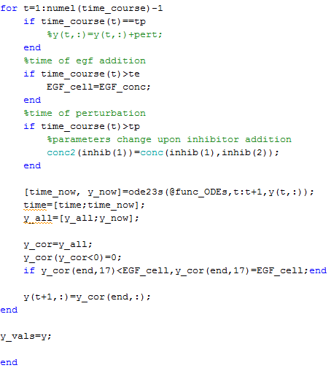
Func2_TimeCourse
“If” statements to generate egf stimulation at te and inhibitor perturbation at tp
Ode23s runs the next function
Y_cor stipulates
No negative values
EGF cannot fall below EGF_conc
Y returns the result for each point in the indicated time course

Slide 28
Model so far
Without fminsearch I’ve gotten a reasonably close fit that responds to EGF
Kind of slow with my stipulations
About 30sec for me to get this
Currently fitting with fminsearch

Slide 29
Inhibitors
Perturbations work
I haven’t started trying to fit them yet
Hopefully we can achieve the trends seen in data

